Slide 1
Airline Safety Analysis Executive Summary
Term Project Milestone 2
Kesav Adithya Venkidusamy
Bellevue University
DSC 640 – T301 Data Presentation and Visualization
Professor: Catherine Williams
Due Date: 07/03/2022

Slide 2
Add a Slide Title - 4

Slide 3
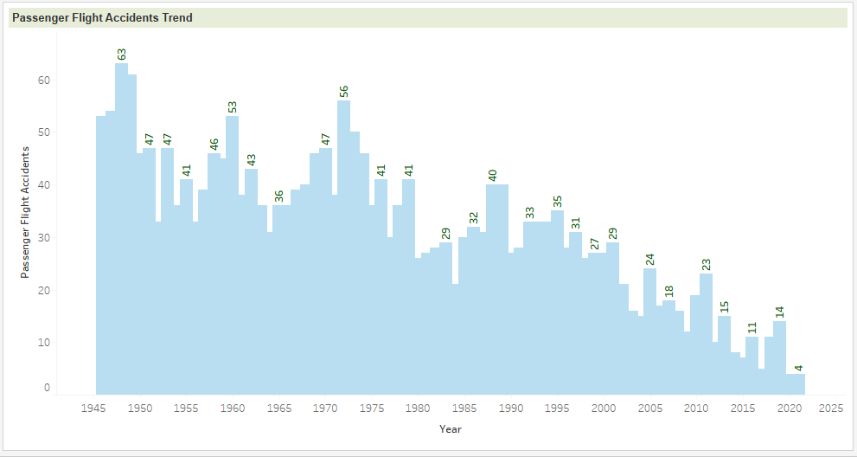
Passenger Airline Accident and Fatality Trend

Slide 4
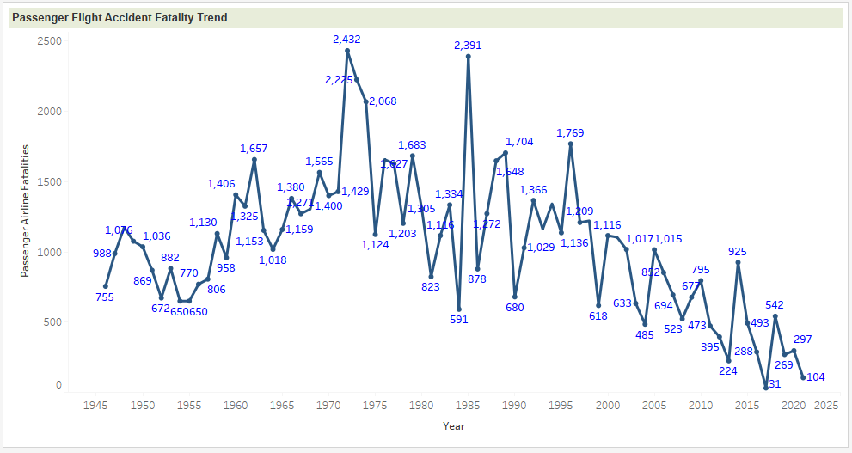
Passenger Airline Accident and Fatality Trend

Slide 5
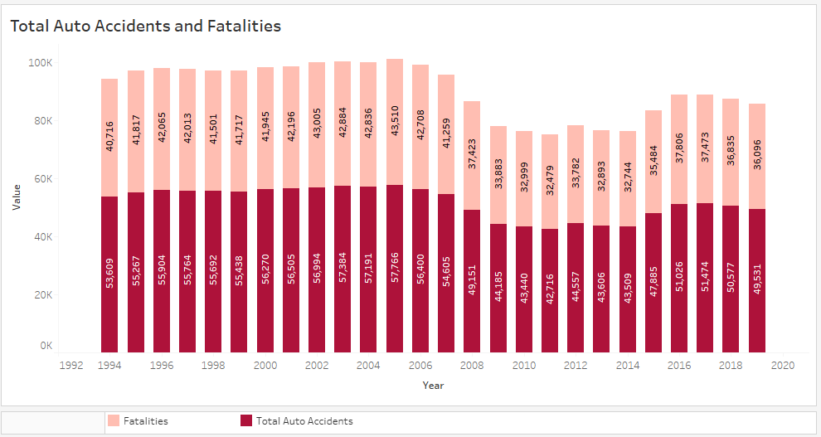
Auto Accidents and Fatalities Trend

Slide 6
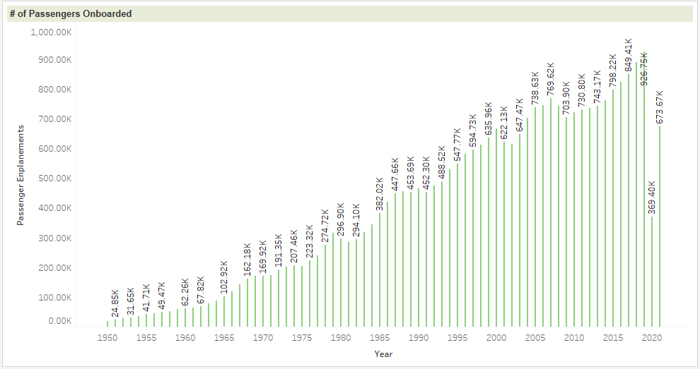
Passenger Enplanements Over Years

Slide 7
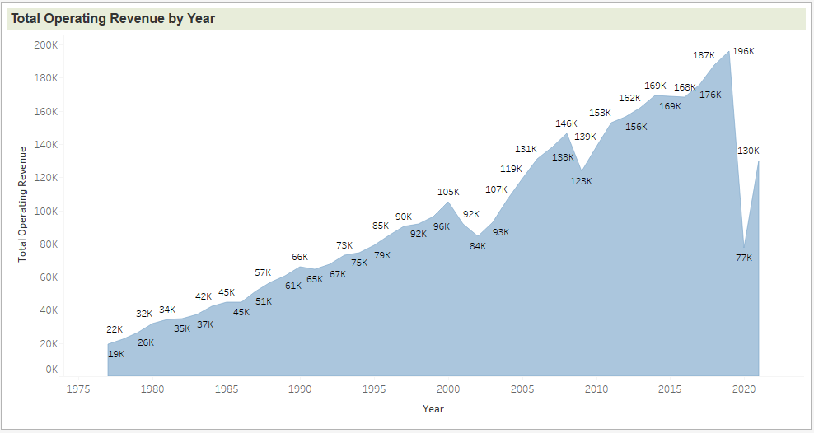
Operating Revenue of Airlines

Slide 8
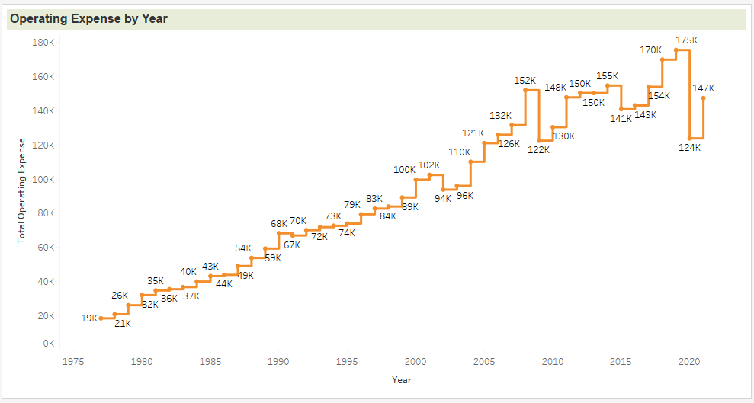
Operating Expense of Airlines

Slide 9
Add a Slide Title - 5

